Slide 1
X1
W1
X2
W2
Activation Function
W3
X3
W4
w1x1+w2*x2+w3*x3+w4*x4
X4

Slide 2
Machine Learning (ML)
Machine Learning is a subset of AI that uses advanced algorithms to detect patterns in large datasets, allowing machines to learn and adapt. ML algorithms use either supervised or unsupervised learning methods.
Deep Learning (DL)
Deep Learning is a subset of ML that uses neural networks for in-depth data processing and analytical tasks. DL leverages multiple layers of artificial neural networks to extract high-level features from raw input data, simulating the way human brains perceive and understand the world.
Artificial Intelligence (AI)
AI involves techniques that equip computers to emulate human behavior, enabling them to learn, make decisions, recognize patterns, and solve complex problems in a manner akin to human intelligence.
Generative AI
Generative AI is a subset of DL models that generate content like text, images, or code based on provided input. Trained on vast datasets, these models detect patterns and create outputs without explicit instruction, using a mix of supervised and unsupervised learning.

Slide 3
X1
W1
X2
W2
Activation Function
Predicted Value (Y')
W3
Actual Value (Y)
X3
W4
w1x1+w2*x2+w3*x3+w4*x4
X4
Sample No. | Actual Value | Predicted Value | Error
1 | 100 | 95 | 5
2 | 200 | 190 | 10
3 | 300 | 295 | 5
4 | 400 | 390 | 10
5 | 500 | 495 | 5

Slide 4
Input layer
Hidden layer
output Layer

Slide 5
Prediction on train data with random weights
Initialize Random Weights
Error=Actual Value-Predicted Value
Update Weights with respect to error

Slide 6
0 | 1 | 0 | 1 | 0
1 | 1 | 0 | 1 | 1
0 | 1 | 0 | 0 | 0
0 | 1 | 0 | 0 | 1
1 | 0 | 1 | 1 | 0
Convolution Filters
Feature Maps
*
1 | 0 | -1
1 | 0 | -1
1 | 0 | -1
=
0 | 1 | 0 | 1 | 0
1 | 1 | 0 | 1 | 1
0 | 1 | 0 | 0 | 0
0 | 1 | 0 | 0 | 1
1 | 0 | 1 | 1 | 0
1 | 0 | -1
1 | 0 | -1
1 | 0 | -1
*
=
0 | 1 | 0 | 1 | 0
1 | 1 | 0 | 1 | 1
0 | 1 | 0 | 0 | 0
0 | 1 | 0 | 0 | 1
1 | 0 | 1 | 1 | 0
1 | 0 | -1
1 | 0 | -1
1 | 0 | -1
*
=
0 | 1 | 0 | 1 | 0
1 | 1 | 0 | 1 | 1
0 | 1 | 0 | 0 | 0
0 | 1 | 0 | 0 | 1
1 | 0 | 1 | 1 | 0
1 | 0 | -1
1 | 0 | -1
1 | 0 | -1
*
=

Slide 7
0 | 1 | 0 | 1 | 0
1 | 1 | 0 | 1 | 1
0 | 1 | 0 | 0 | 0
0 | 1 | 0 | 0 | 1
1 | 0 | 1 | 1 | 0
*
=
Image
Multiple Convolution Filters
Feature Map

Slide 8

Data
Transform
Images
Data Loader
Convolution layer
Pooling layer
Convolution layer
Pooling layer
Flattening Layer
Fully Connected Dense layer
Output Layer
SoftMax/Sigmoid
Data Loading & Preprocessing
Input
Classification layer
Feature Learning

Slide 9
2 | 4 | 3 | 1
5 | 1 | 7 | 8
9 | 2 | 6 | 4
3 | 6 | 0 | 2
4 | 8
9 | 6
Max Pooling

Slide 10
Pretrained Model
Output
Input Layer
Mid Layers
Later layers
Custom Model
Output
Input Layer
Mid Layers
Custom Trained Model

Slide 11
Regional Proposal Network
(suggests potential object-boundary boxes (called proposals)
Region of Interest Heads
Box Head: For bounding box regression and object classification.
Mask Head: For generating segmentation masks in instance segmentation tasks.
KeyPoint Head: For KeyPoint detection tasks.
Input Layer
Backbone Network
(The backbone can be any standard (CNN) like ResNet, ResNeXt, EfficientNet. processes the input image and extracts a feature map.)
Feature Pyramid Network
(takes the feature map from the backbone and creates a pyramid of feature maps at different scales.)
Output

Slide 12
Time Step 1
Time Step 2
Time Step 3
Recurrent Unit
Recurrent Unit
Recurrent Unit
h1
h2
h3
x1
x2
x3
h1 =tanh(Wh⋅h0 +Wx⋅x1 )
h2 =tanh(Wh⋅h1 +Wx⋅x2 )
h3 =tanh(Wh⋅h2 +Wx⋅x3 )

Slide 13
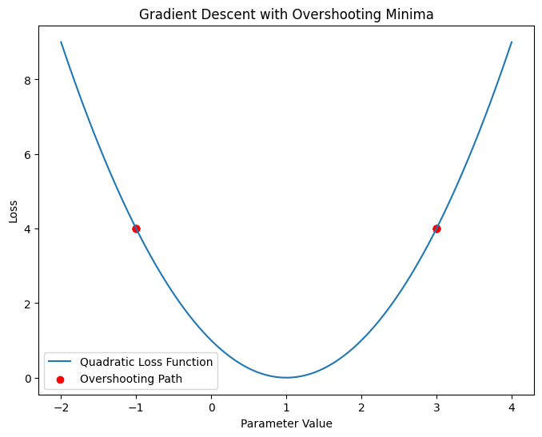

Slide 14
| 0.45 |
| -0.12 |
| 0.88 |
| -0.33 |
| 0.07 |
Huge amount of input text to RNN/LSTM
Context vector
RNN/LSTM

Slide 16

giraffe
eating
<end>
| 0.45 |
| -0.12 |
| 0.88 |
| -0.33 |
| 0.07 |
CNN
Feature vector
RNN/LSTM
Input Image

Slide 17
| 0.45 |
| -0.12 |
| 0.88 |
| -0.33 |
| 0.07 |
Huge amount of input text to RNN/LSTM
Context vector
RNN/LSTM

Slide 18
Encoder
Decoder
Input
Context Vector
Output
Non RNN Attention Based
Non RNN Attention Based

Slide 19
Convolution Gan
1 1 1 0 0 1 1 1 0 0 1 1 1 0 0 0 0 0 0 0 0 0 0 0 0
1 0 1
0 1 0
1 0 1
4 3 4 3 4 3 4 3 4
X
=
Upscaling Matrix
1 0 2 0 2 0 1 0 2 0 3 0 4 0 4 0 3 0 4 0 3 0 4 0 4
1 2 3 4
X
1 0 1
0 1 0
1 0 1
=

Slide 20
Downscaling Matrix
1 1 1 1 1 1 1 1 1 1 1 1 1 1 1 1
4 4
4 4
1 0 1 0 1 0 1 0 1
=
X

Slide 21
The
The
The
The
animal
animal
animal
animal
didn't
didn't
didn't
didn't
cross
cross
cross
cross
the
the
the
the
street
street
street
street
because
because
because
because
it
it
it
it
was
was
was
was
too
too
too
too
tired
tired
wide
wide
It is in reference to the animal.
It is in reference to the street.

Slide 22
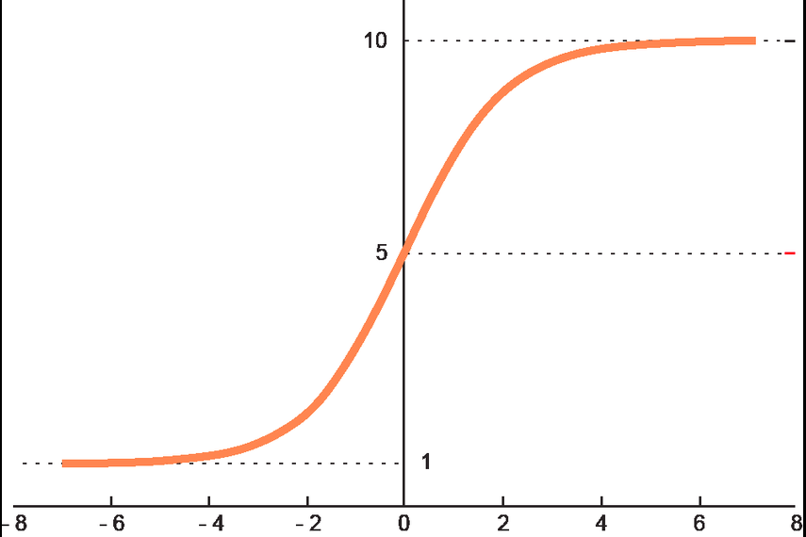
Positional encoding is added to each word embedding to incorporate the position of words in the sentence
Position 1 (Hello): Positional Encoding → [0.1, 0.2, 0.3]
Final Input: [1.2+0.1,0.4+0.2,0.7+0.3]= [1.3, 0.6, 1.0][1.2+0.1,0.4+0.2,0.7+0.3]=[1.3,0.6,1.0]
Hello, how are you
[Hello, how, are, you]
Hello → [1.2, 0.4, 0.7]
how → [0.8, 1.1, 0.5]
are → [0.9, 0.6, 0.2]
you → [1.0, 0.7, 0.9]
Input Sentence
Tokenized Sentence
Token is mapped to a fixed-size numerical vector using a pre-trained embedding
Linear Transformation
Calculate Attention Scores by taking the dot product of each Query (Q) vector with all Key (K) vectors.
Example (Dot Product):
Attention of "Hello" on itself: Q_Hello · K_Hello
Attention of "Hello" on "how": Q_Hello · K_how
... (similarly for all pairs)
For each token, we create three vectors (Q, K, and V) using linear transformations
Hello → Q: [0.5, 0.3, 0.7], K: [0.2, 0.8, 0.4], V: [0.9, 0.1, 0.6]
how → Q: [0.6, 0.4, 0.9], K: [0.1, 0.7, 0.5], V: [0.8, 0.3, 0.7]
... (similar for "are" and "you")
Softmax Function
The scores are normalized using the SoftMax function to convert them into probabilities.
Attention of "Hello": [0.4, 0.3, 0.2, 0.1]
(Hello pays 40% attention to itself, 30% to "how", etc.)
Weighted Sum of Value Vectors
Weighted Sum = (0.4 * V_Hello) + (0.3 * V_how) + (0.2 * V_are) + (0.1 * V_you)
Contextual Embeddings
the weighted sum becomes its contextual representation
Hello → Context: [1.1, 0.5, 0.8]
how → Context: [0.9, 0.6, 1.0]
... (similar for other words)

Slide 23
Contextual Embeddings
Hello → Context: [1.1, 0.5, 0.8]
how → Context: [0.9, 0.6, 1.0]
... (similar for other words)
Generate <start> token
Applies masked Self Attention to generated tokens

